Slide 1
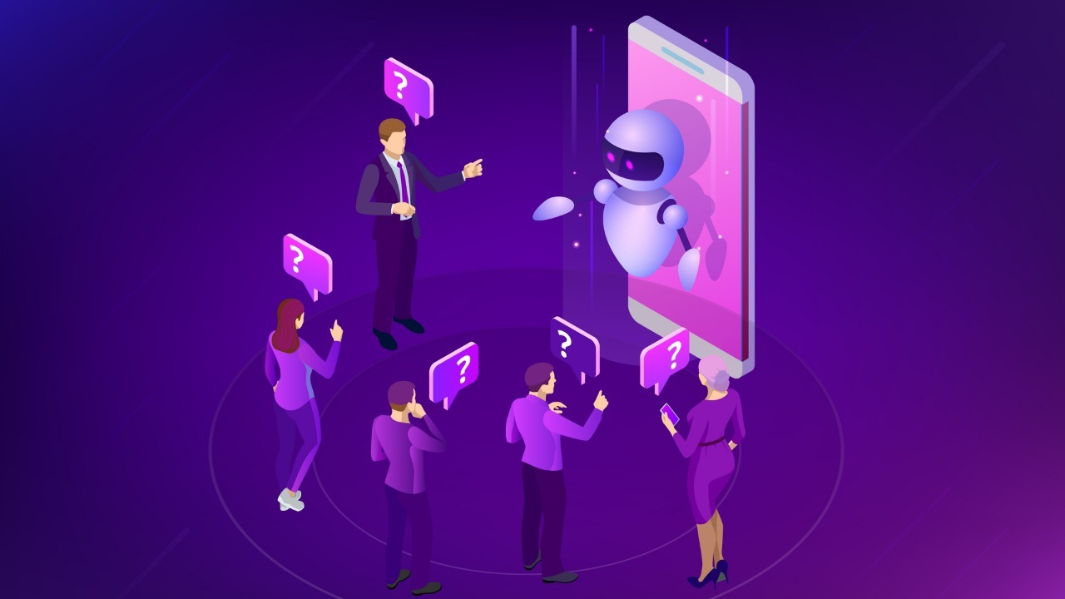

DERNELL
The Attendance Bot

Slide 2
Team members
Samsritha Chowdary Mandhadapu-20BCI7166
Mithun Shivakoti-20BCI7134
Jeeveth Koka-20BCI7126

Slide 3
OVERVIEW
TECH STACK
BACKEND
DEVELOPER’S & USER’SVIEW
VISIT US!
INTRODUCTION
ABOUT
HOW TO USE
QUICK DEMONSTRATION

Slide 4
INTRODUCTION
A chatbot is a software application used to conduct an on-line chat conversation via text or text-to-speech, in lieu of providing direct contact with a live human agent.

Slide 5
ABOUT
The objective of this software is unlike the manual process, an online system easily helps management to analyse student's attendance details as per requirement.
Attendance Management System is software for daily attendance in schools, colleges, or during any events/workshops.

Slide 6
HOW TO USE ?
1.Save +1(415)523-8886 to your contacts.
2. Open the WhatsApp chat of the saved contact.
3. Send the code(join bridge-cloth) told by the faculty / organizer to the chat bot.
4.Send your activity status.
5. Answer the question.
6.Finally send a bye to the chat bot and close the chat.

Slide 7
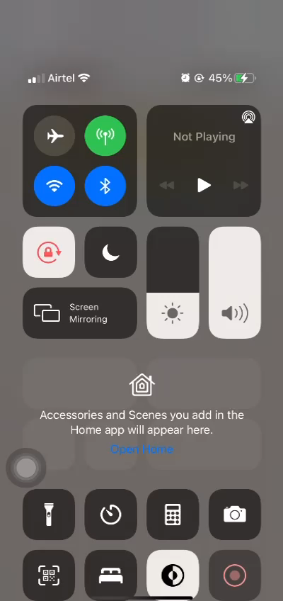
Quick Demonstration

Slide 8



Tech STACK
IBM CLOUD
TWILIO
WHATSAPP

Slide 9
BACKEND
DERNELL is made using IBM Cloud’s Watson assistant
Watson Assistant allows as to integrate our chatbots to our personal websites and also 3rd party integrations like Twilio and Slack.
Twilio provides us with a activation code for each chatbot so as to talk to it.

Slide 10
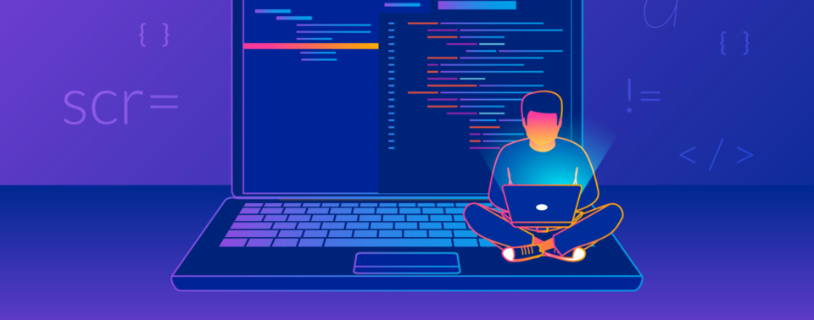

VIEW
DEVELOPERS VIEW
USERS VIEW

Slide 11
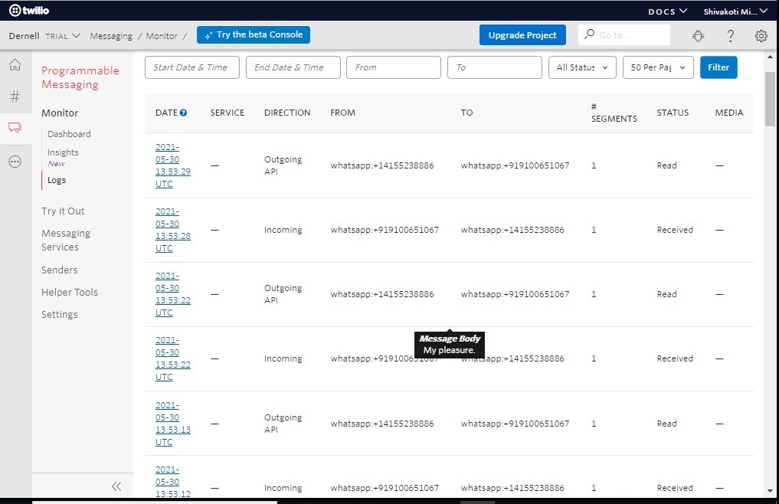
DEVELOPER’S VIEW

Slide 12
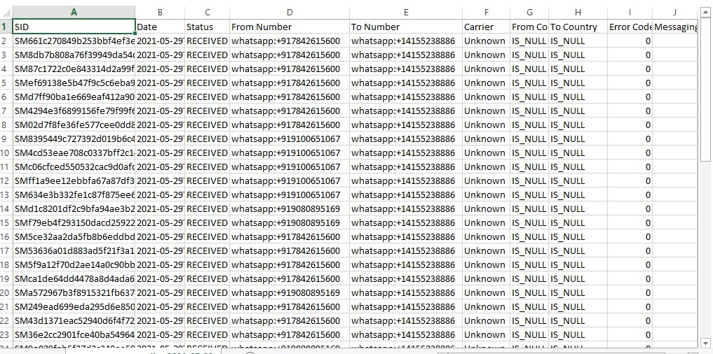
DEVELOPER’S VIEW

Slide 13
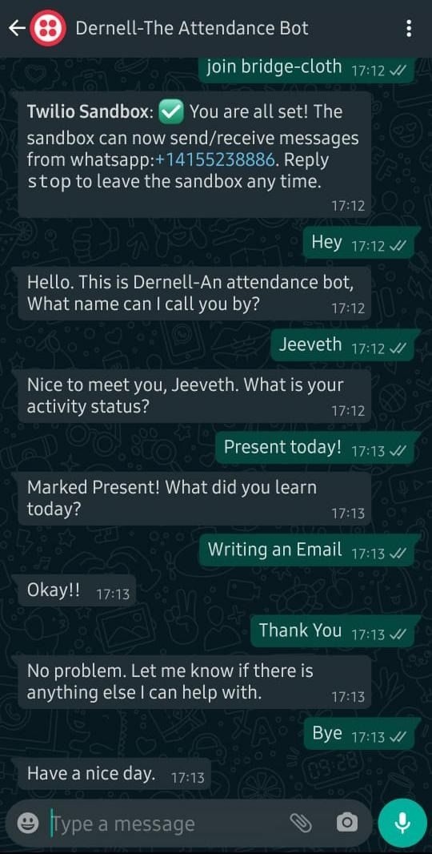
USER’S VIEW

Slide 14
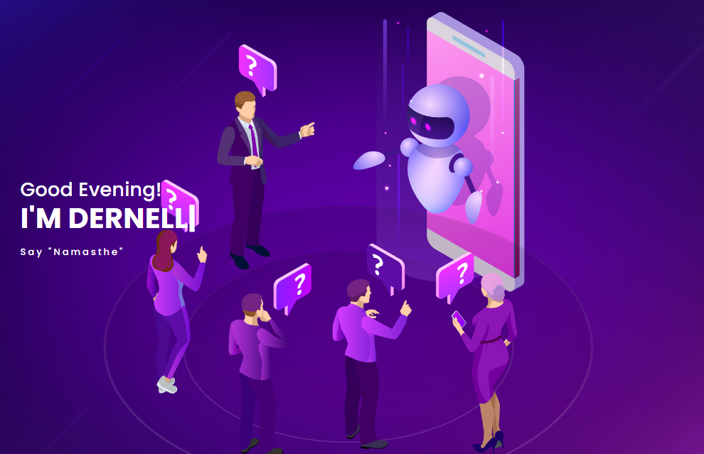
VISIT US!
www.dernell.netlify.app

Slide 15


